Slide 1
Overview of Industrial Robot Group Activities
Dr. Stephen Balakirsky
National Institute of Standards and Technology
stephen@nist.gov

Slide 2
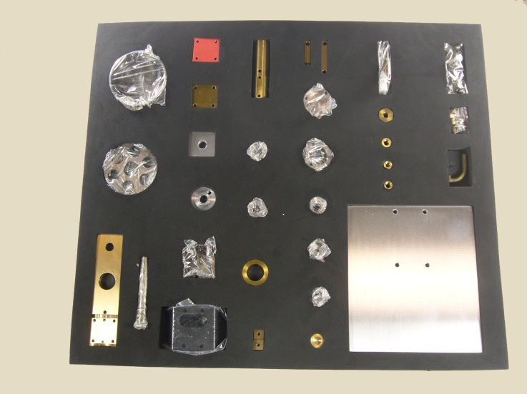

Kit Building
Process in which individually separate but related items are grouped, packaged, and supplied together as one unit
Utilized in many manufacturing assembly lines
Robotic solution requires:
Flexibility –Many parts with varying characteristics, part-to-part inconsistences
Agility – Changes in part supply locations, lack of fixturing
Rapid re-tasking – Ability to quickly build new varieties of kits

Slide 3
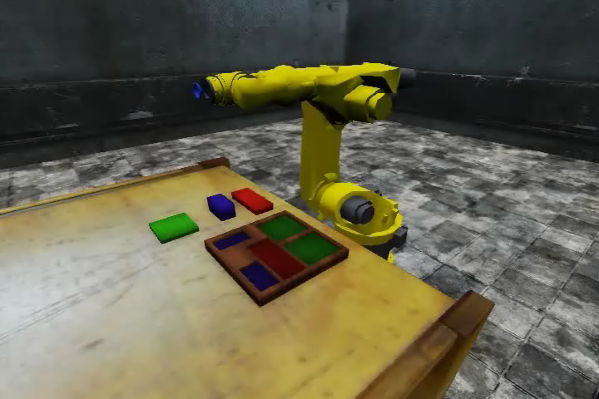
Operational System
Video is 2x real time

Slide 4
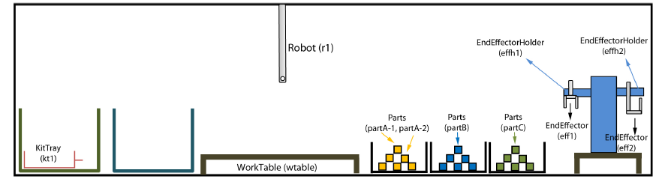
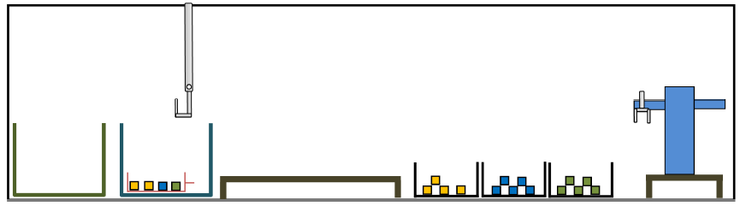
Planning Problem
Ƥ = (Ʃ, s₀, g)
Ʃ - State transition system (possible actions)
S₀ - Initial conditions (objects and relationships)
g – Goal conditions
Initial Condition
We would like to examine the knowledge requirements of this planning problem
Goal Condition

Slide 5
Underlying Knowledge Representation
Actions
What actions and attributes are relevant
Necessary conditions for an action to occur
Likely results of the action
Objects
What objects and attributes are relevant
Taxonomy of objects
Relationships between objects
Dynamic world
Object attributes change over time
Actions do not always accomplish what we want them to
Desire to maintain OWL compliance

Slide 6
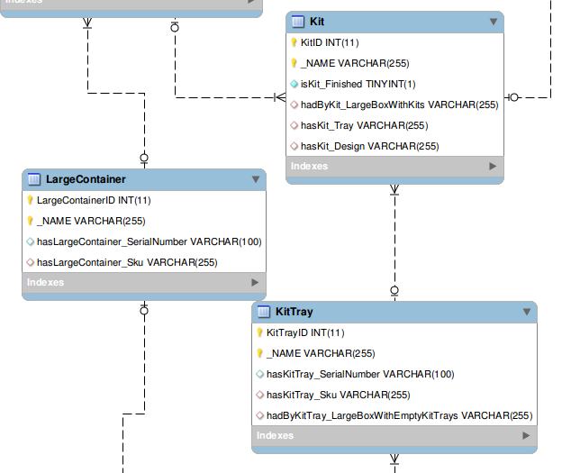
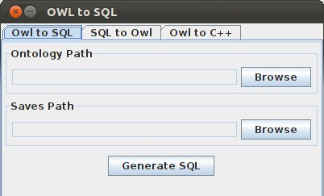
Limitations of OWL
Set of static files with no real-time information
Can auto-generate MySQL database from OWL instance file and maintain database with sensor processing (access functions also auto-generated)
Can automatically re-generate OWL instance file to allow for continued reasoning
No way to encode preconditions and effects of actions
OWL Services (OWL-S) and the Semantic Web Rule Language (SWRL) are extensions that provide for actions with preconditions and effects
Image from mysql-workbench

Slide 7
OWL-S Model
Requires generation of OWL-S syntax for rule, pre-conditions, and effects
Requires generation of SWRL (Semantic Web Rule Language) rules
Support issues with Protégé 4.2 plug-ins

Slide 8
OWL/OWL-S Issues
Naïve user, but…
SWRL Rules
Very verbose data entry
Difficult/impossible to represent negation
OWL Instance Modification
Open world assumption allows spelling errors
Need to follow complex trail of tables and pointers
Removal of instance requires careful clean-up to remove “hanging” entries
Is there another way?
Investigated use of XML and PDDL with automatic generation of OWL files

Slide 9
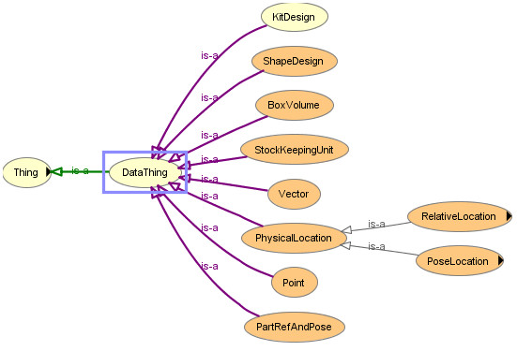
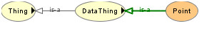
Ontology Design: Protégé View
OWL Viz view of KitDesign
Arguably little or no useful information presented
Is there a better way to visualize the representation?

Slide 10
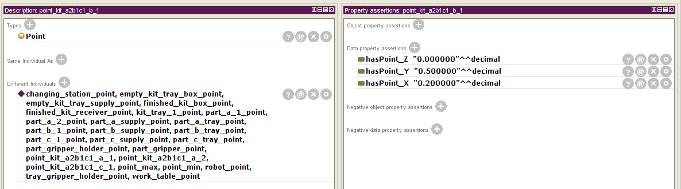
Data Entry – Protégé View
Required to navigate multiple tables
Required to add pointers from table to table
Required to typecast every data entry
Is there a better way to perform data entry?

Slide 11
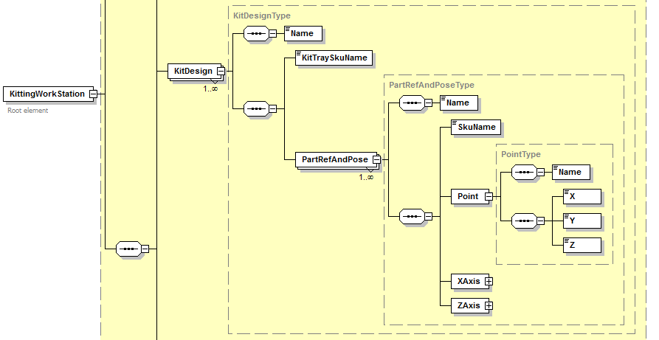
Ontology Design
Clearly shows elements, element structure and properties, and classes

Slide 12
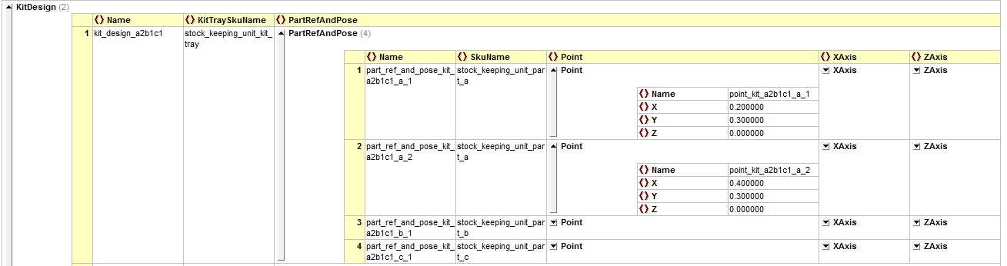
Data Entry
Able to see all relevant fields for data entry
Strictly typecast

Slide 13
XML Knowledge Representation
Preceding two slides¹ were views into XML representation
We have created XML->OWL conversion tools
Can automatically generate an OWL “instance” file from an XML file
Work currently underway to generate OWL “class” file from XML schema
XML provides
Closed world assumption
Type checking
Consistency checking
¹Images created with XML Spy product. NIST does not endorse or recommend any commercial product.

Slide 14
Back To SWRL: State-Variable Representation
Our real purpose in using OWL-S and SWRL is to encode actions, preconditions, effects, and plans
State-Variable Representation¹ (SVR) used to formally define environment’s state and actions
Each state is represented by a tuple of values of n state variables {x₁,…, x_{n}}
Action is represented by a partial function that maps this tuple into some other tuple of values of the n state variables
¹Dana Nau, Malik Ghallab, and Paolo Traverso. 2004. Automated Planning: Theory & Practice. Morgan Kaufmann Publishers Inc.

Slide 15
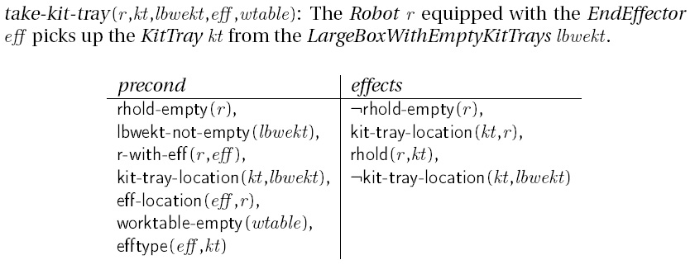
Compose SVR in Planning Domain Definition Language (PDDL)
SVR is not a standard interchange language
Can use the PDDL to encode the SVR
Entire kitting domain composed of:
9 high-level operators: take-kit-tray, put-kit-tray, take-kit, put-kit, take-part, put-part, attach-eff, remove-eff, create-kit
28 predicate expressions that act as preconditions or are acted upon during effects: rhold-empty, r-with-eff, kit-tray-location, worktable-empty, …

Slide 16
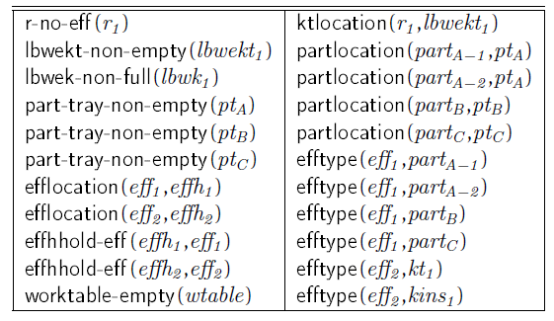
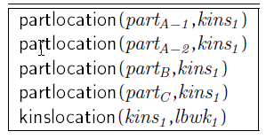
Compose SVR in Planning Domain Definition Language (PDDL)
Initial Condition
Initial Condition encoded as set of predicate expressions
Goal Condition encoded as set of predicate expressions
Plan necessary to move from initial predicates to goal predicates
Goal Condition

Slide 17
System Alternatives?
System Execution
System Execution
Auto-gen
MySQL database, PDDL plan file
MySQL database, PDDL plan file
Auto-gen
PDDL Domain, Problem files
OWL “Domain”, “Initial Condition”, “Goal Condition” files
Hand created
PDDL Domain, Problem files, code for predicate generation
OWL-S, SWRL Rule files
Hand created
XML Schema, “Initial Condition”, “Goal Condition” files
OWL “Domain”, “Initial Condition”, “Goal Condition” files

Slide 18
Both Techniques Provide Agile System
Video is 2x real time

